Slide 1
Enterprise Resource Planning(ERP) System in KSA
Name
Institution of Affiliation

Slide 2
Enterprise Resource Planning(ERP)
ERP software collects, store manage and interpret data for many business activities.
The technology is built to improve communication and monitor data in health care organization, making it easy to access and interpret up to date organization facts and figures.
Healthcare providers in Saudi Arabia can take advantage of ERP to minimize costs and provide quality patient care.
Minimizing cost will enhance health access in Saudi Arabia.
Notes:
ERP binds different computer systems for a large organization such as health. The system allows each department to have its own system optimized for division particular tasks (Ahluwalia et al., 2019). Thus, it would allow KSA healthcare system to share and communicate information easily with the rest of the organization. . It makes medical operations and subsequent test programs easier and enhances healthcare facilities to match patients' wishes and feedback connected to the hospital's environment. By minimizing redundancy and manual entry, enterprise resource planning solutions can assist healthcare organizations in being more time efficient and increasing production. As a result, there is easy access for health in the country.

Slide 3
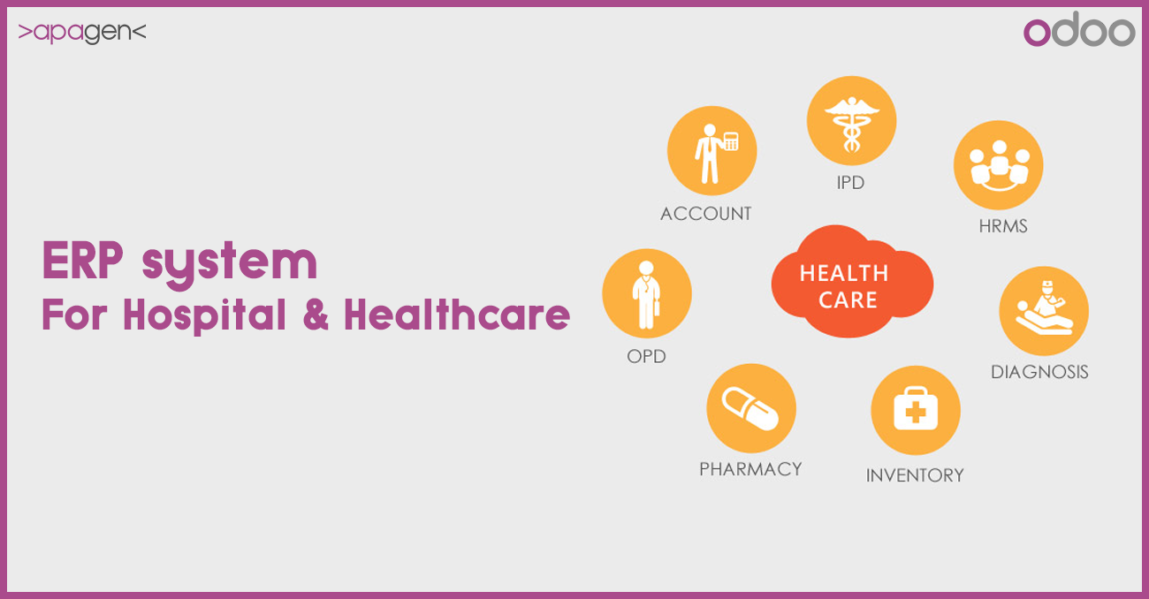
Notes:
Figure depicts the relevance of ERP system in the various healthcare departments.

Slide 4
Improving Patient Care
The information about patients can be maintained and transmitted between divisions within an organization.
Additionally, ERPs frequently include artificial intelligence (AI) and automation features.
Medical professionals nurses and doctors, can take advantage of this functionality to make data-driven judgments and treatment plans with more ease.
Notes:
Patients' information should be stored and transferred between all healthcare providers. Adopting ERP in the country allows patients' records to be updated as a result of any visits to the doctor's office, the emergency room, or the x-ray lab (Naqi et al., 2021).Because all of the required information is readily available, doctors can make the best diagnoses and give the best treatment possible, and insurance companies can process payments more quickly as a result of the increased availability of information. ERP delivers access to critical reports and databases to patients and helps them make timely decisions about their treatment.

Slide 5
Reduce Labor and Operational Costs
ERP will facilitate integration of departments such as billing, finance, inventory and supplies.
This will enable minimization of labor and operation costs.
There will also be better tracking of data in hospital administrators to identify wasted resources, minimize unnecessary costs and optimizing staffing levels.
Notes:
Contributes to the control of operational costs and the pursuit of profit maximization opportunities. Integrated departments such as billing, finance, inventory and supplies, and human resources will benefit from healthcare-related ERP systems in terms of lowering overhead and increasing efficiency. Labor expenditures are one of the most significant line items in any firm, making it imperative to keep them under control in order to maintain profitability. However, keeping track of labor costs, analyzing where employees are spending their time, and identifying efficiencies to save money on labor can be tough and time-consuming tasks that need significant effort. An ERP system can assist in giving real-time data, assisting in the construction of better schedules, and improving your output. It will eventually result in a more productive and efficient healthcare system, as well as the ability to keep labor expenses under control.

Slide 6
Improving Financial Planning
ERP system implementation allows better management of finances.
The system provides hospital accounting system as well as management of tax, bills, inventory schedules and medical equipment costs.
Improved financial planning aids in managing profitability and financial chart.
Hospitals in Saudi Arabia can easily track of patients’ payment and supplies operation costs.
Notes:
ERP system implementation allows better management of finances. Hospitals in Saudi Arabia can easily track of patients’ payment and supplies operation costs. Moreover, adopting ERP aids in minimizing administrative costs and inventory errors. Also, it aids employees including nurses to save time by handling distribution and purchasing responsibilities. ERP financial management software assists you in streamlining your procedures, increasing accuracy, and lowering your costs. When financial operations are automated, analytics provides valuable knowledge, and management choices are made in a more timely and effective manner. Moreover, ERP systems are utilized to prevent accounting errors and keep track of the activities of the organization.

Slide 7
Strategic and Automation Planning
A full ERP platform that is automated enables medical professionals and doctors to easily manage patients records, manage appointments and prescriptions.
A healthcare organization can easily manage payrolls with automated reports and calendars.
An ERP can also be used in planning integration, sales, marketing, human resource and purchasing inventory.
Through the software, healthcare in Saudi Arabia can easily decide on the future of the organizations with an aim of increasing easy access to health.
Notes:
Healthcare managers might benefit from using enterprise resource planning (ERP) to aid them in developing a strategic plan. It identifies and focuses on areas that need to be improved, hence increasing the overall efficiency of the healthcare system(Rouhani and Mehri, 2018).Once the areas that require improvement have been identified, it will be much easier for top management to monitor and assess whether the methods already in place are effective or not. An ERP can also be used in planning integration, sales, marketing, human resource and purchasing inventory. Through the software, healthcare in Saudi Arabia can easily decide on the future of the organizations with an aim of increasing easy access to health.

Slide 8
Allow electronic storage of Health-related information
By adopting the technology, Saudi Arabia hospitals and healthcare industry are able to keep data about their operations and those of patients safe.
Implementing ERP in the country ensures confidentiality and safety of all information.
Using state-of-the-art technology minimizes the risk of losing vital information and ensure only users have access.
Notes:
ERP ensures that healthcare providers in Saudi Arabia can easily update all data in the system (Cheng, 2019). Besides, using state-of-the-art technology minimizes the risk of losing vital information and ensure only users have access. Through the use of an additional application or modules referred to as a "bolt-on," health organization can add capabilities that were previously lacking and increase the value of their ERP system. ERP bolt-ons add extremely particular functionality or technology to ERP systems, allowing them to work in conjunction with them. Bolt-ons include customer relationship management (CRM), advanced supply chain management (ASCM), vendor relationship management (VRM), and human resource management (HRM).

Slide 9
Supply of Business Intelligence
ERP provides vital information to healthcare mangers for budgeting, patients visitations analysis and status of requisitions.
With the use of ERP, physicians have a valuable asset in offering the right care to the right patient at the right time.
Business intelligence may assist healthcare providers in gaining the knowledge they require to cut the cost of healthcare.
This can also be used to improve patient safety and results.
Notes:
ERP offers a foundation for evidence based clinical decision-making. Business intelligence improves patients outcome allowing physicians to monitor and predict patients diagnoses better. With better supply of business intelligence, healthcare providers can control costs and improve operation efficiency (Aldossari and Mokhtar, 2020). Business intelligence may assist healthcare providers in gaining the knowledge they require to cut costs, enhance revenue, improve patient safety and results, and do so while remaining compliant with legislation and industry standards. As a result there is easy visibility in financial operations including generating compliance reports and monitoring of cash flows.

Slide 10
References
Ahluwalia, V., Larsen, T. L., Kennedy, C. A., Inrig, T., & Lundon, K. (2019). An advanced clinician practitioner in arthritis care can improve access to rheumatology care in community-based practice. Journal of multidisciplinary healthcare, 12, 63.
Aldossari, S., & Mokhtar, U. A. (2020). A model to adopt enterprise resource planning (ERP) and business intelligence (BI) among Saudi SMEs. International Journal of Innovation, 8(2), 305-347.
Cheng, Y. M. (2019). A hybrid model for exploring the antecedents of cloud ERP continuance: Roles of quality determinants and task-technology fit. International Journal of Web Information Systems.
Naqi, M., Mukhtar, A. H., & Hamdan, A. (2021). Impact of Innovative Technologies in Healthcare Organization Productivity with ERP. In Applications of Artificial Intelligence in Business, Education and Healthcare (pp. 309-330). Springer, Cham.
Rouhani, S., & Mehri, M. (2018). Empowering benefits of ERP systems implementation: empirical study of industrial firms. Journal of systems and information technology.

